Slide 1


MSC3182
SOCIAL ENTREPRENEURSHIP
Lesson 3
IDENTIFY YOUR CUSTOMER SEGMENT AND NICHE

Slide 2
OBJECTIVES
In this lesson, you will
Identifying your Customer Segments
Niche market

Slide 3
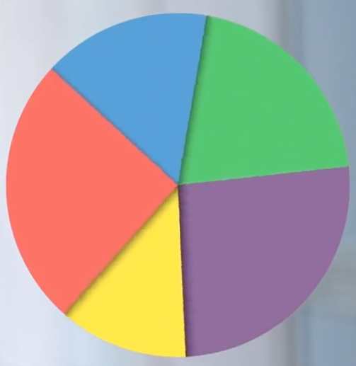

WHO IS YOUR CUSTOMER?
Identifying / Discovering your Customer is not easy
Logical start to understand the different customers and how to target them
Segmentation and Targeting
Deciding potential costumer segments to focus on
Way of chopping up the market

Slide 4
SEGMENTATION
Marketing Segmentation always comes before Targeting
Cannot Please everyone
May end up pleasing no one
Expensive to sell a lot
Helps to select how you need to market your product
Select the customer segment best match for your product

Slide 5
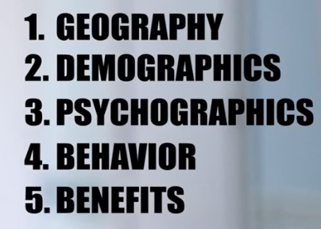
SEGMENTATION
Several ways to divide a market
Segment market by towns or countries
Gender, age, religion, occupation, etc.
Lifestyle segmentation
User behaviour, Frequency of use
Benefits the customer wants

Slide 6

HOW NEW ENTREPRENEUR SELECT MARKET SEGMENT
Several ways
WHOLE MARKET
SINGLE SEGMENT
SEVERAL SEGMENT
NICHE
Mass Marketing
Very specific Needs

Slide 7
SEGMENTATION
Video: Segmentation and Targeting
https://lms.learnwise.org/IN/en/lesson/view?sid=5430502&vid=5430810&cid=5430669&cat_id=18845&user_gids=6045898

Slide 8
ACTIVITY - IDENTIFY YOUR CUSTOMER SEGMENT
Instructions
Regroup into your teams of 5.
Brainstorm on 3-4 customer segments for your product/service.
Each person can write them down on post-its.
Discuss together as a team and pick 2 final segments.
You have exactly 10 minutes to complete this activity.

Slide 9
ACTIVITY - IDENTIFY YOUR CUSTOMER SEGMENT
TIPS
The size of the segment should not be too small or too big.
The rough rule of thumb is: penetration between 1 to 15 percent of the target segments should be sufficient to give satisfactory sales.
The segment should be distinct.
It should have specific needs different from the market.

Slide 10

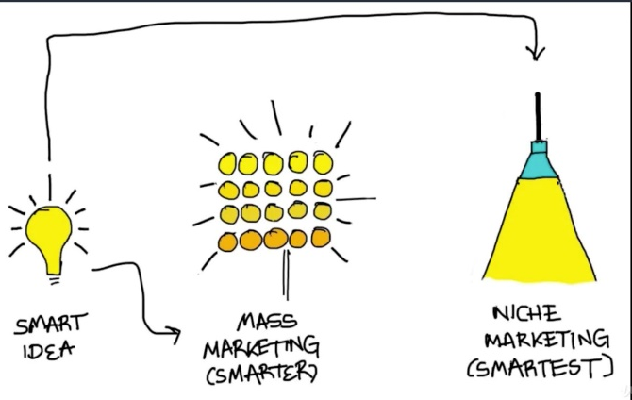
NICHE MARKET
Most Appropriate for new venture
Difficult to target a large market
Direct competition from big players
Big players are able to spend huge money to reach the customer

Slide 11


WHY TARGET NICHE MARKET?

Slide 12

WHY TARGET NICHE MARKET?
Video: Niche Marketing
https://lms.learnwise.org/IN/en/lesson/view?sid=5430502&vid=5430817&cid=5430669&cat_id=18845&user_gids=6085747

Slide 13
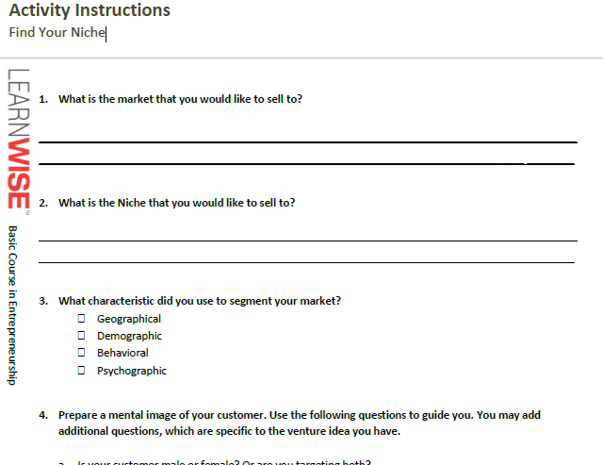
WHY TARGET NICHE MARKET?
Activity Instructions Find Your Niche

